Slide 1
Simulating 2 and 3 Gravitational Body Systems By: Aditya, Kaushik, and Pratyush

Slide 2
Aims and Objectives
Demonstrate the conservation of Linear Momentum by:
Building a 2D model of gravitational forces
Building a 3D model of gravitational forces
Model a 2 body system in 2D that does not lose energy using Verlet Integration.
Model the Voyager’s gravitational slingshot around Jupiter.
Model stable and chaotic three body systems, using RK4 Integration.

Slide 3
Two Body System Code Snippets

Slide 4
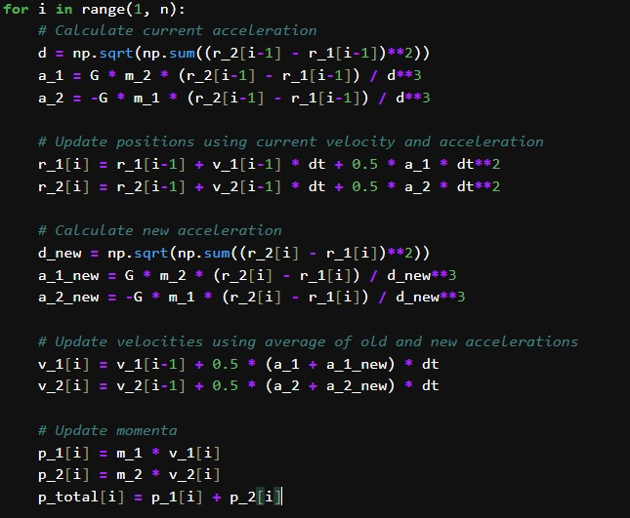

Slide 5
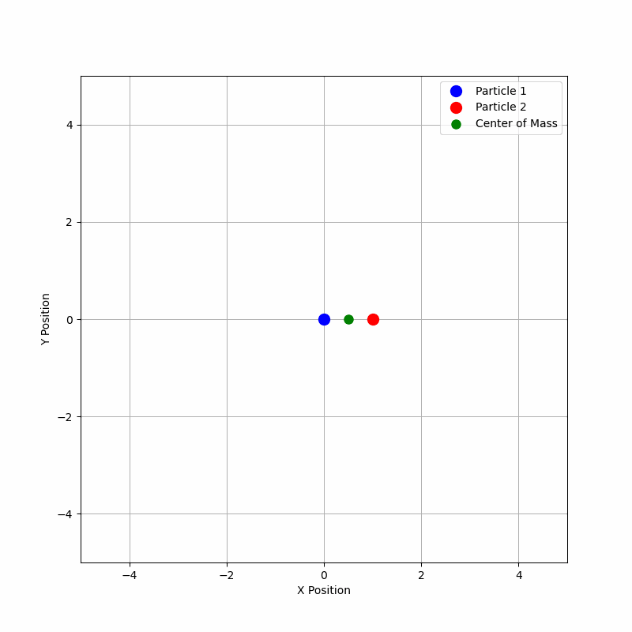

Slide 6
Three Body System Code Snippets

Slide 7
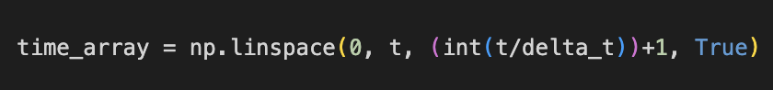
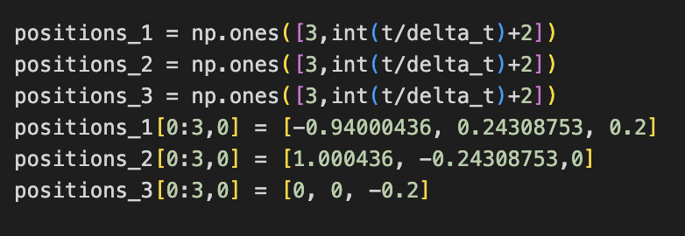
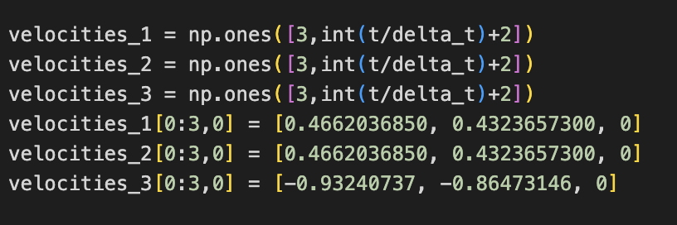
X - Position | S_{x1} | … | S_{xf}
Y - Position | S_{y1} | … | S_{yf}
Z - Position | S_{z1} | … | S_{zf}

Slide 8
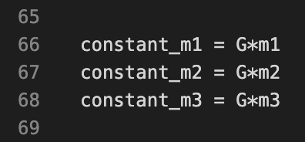
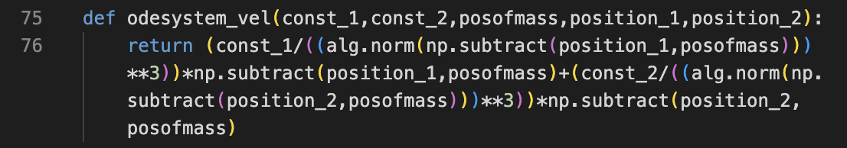




$$F=\frac{Gm_{i}m_{j}}{{\left|\vec{r_{ij}}\right|}^{3}}\left(\vec{r_{ij}}\right)$$
$$\vec{F_{1}}=\frac{Gm_{1}m_{2}}{{\left|\vec{r_{12}}\right|}^{3}}\left(\vec{r_{12}}\right)+\frac{Gm_{1}m_{3}}{{\left|\vec{r_{13}}\right|}^{3}}\left(\vec{r_{13}}\right)$$
$$\vec{F_{2}}=−\frac{Gm_{1}m_{2}}{{\left|\vec{r_{12}}\right|}^{3}}\left(\vec{r_{12}}\right)+\frac{Gm_{2}m_{3}}{{\left|\vec{r_{23}}\right|}^{3}}\left(\vec{r_{23}}\right)$$
$$\vec{F_{3}}=−\frac{Gm_{1}m_{3}}{{\left|\vec{r_{13}}\right|}^{3}}\left(\vec{r_{13}}\right)−\frac{Gm_{2}m_{3}}{{\left|\vec{r_{23}}\right|}^{3}}\left(\vec{r_{23}}\right)$$

Slide 9
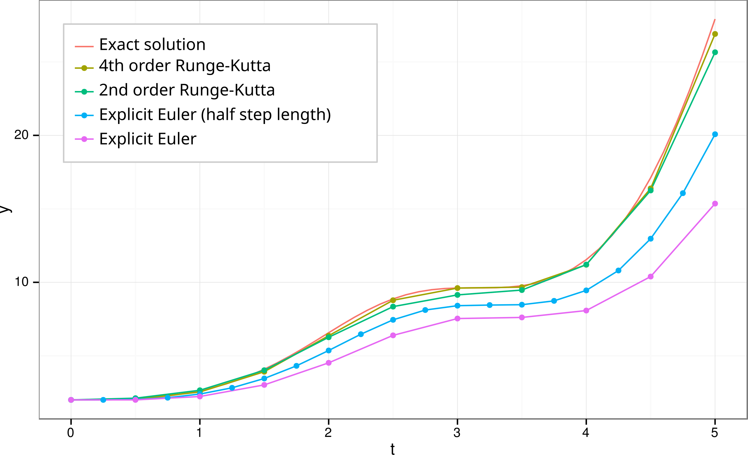

The RK4 iterative method uses a family of slopes around a function$f\left(x, t\right)=\frac{dx}{dt}$.
In this case, we use it first to find acceleration from some position, which is:
$$f\left(x, t\right)=\frac{dv}{dt}=a$$
And then we find velocity:
$$v=u+at$$
Which we then use to find position:
$$S_{n+1}=S_{n}+vt$$
Positions and Velocities, calculated using the RK4 iterative method were updated to the arrays described to slides ago using append.

Slide 10
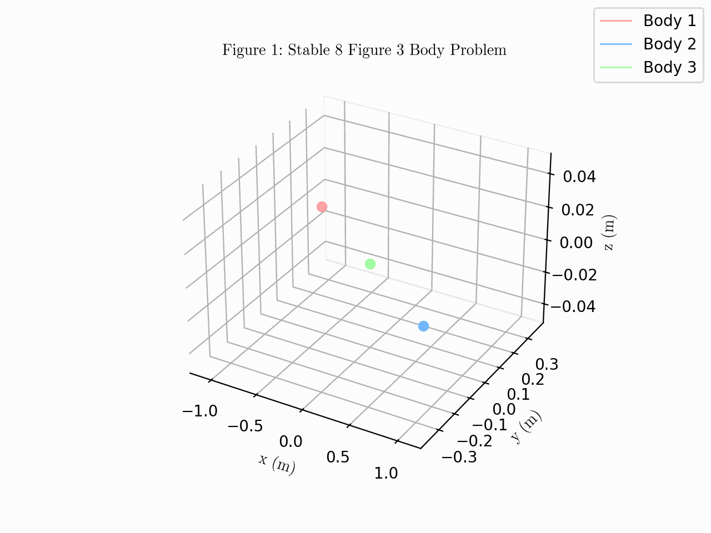
A stable 3 Body System. Forming a figure 8, the most common solution and most well known solution to the 3 Body System.

Slide 11
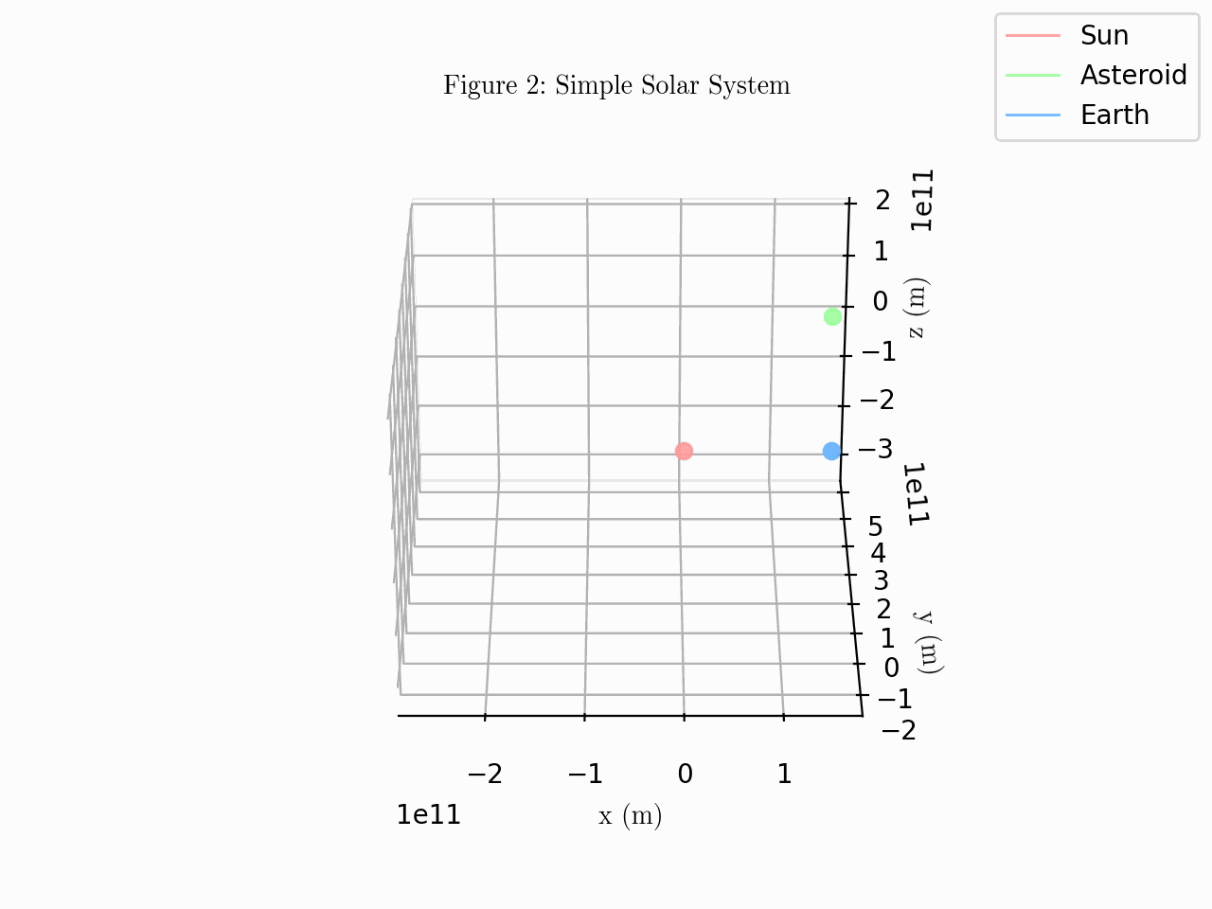
A stable 3 Body System. A simple solar system, the asteroid accidentally has the mass of Jupiter, giving it the slow orbit that it has.

Slide 12
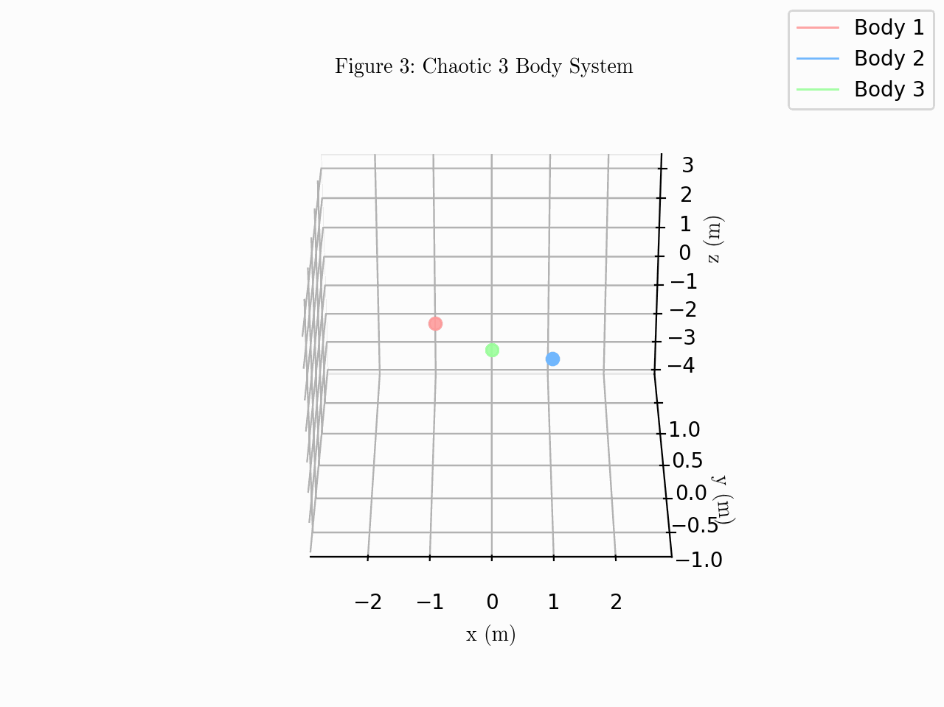
A chaotic three body system, the initial positions were changed on the z-axis.

Slide 13
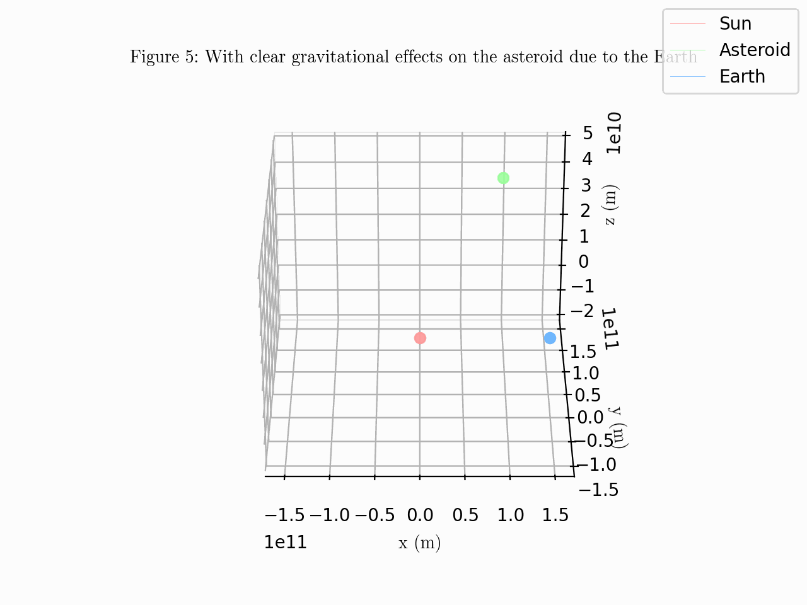

Slide 14
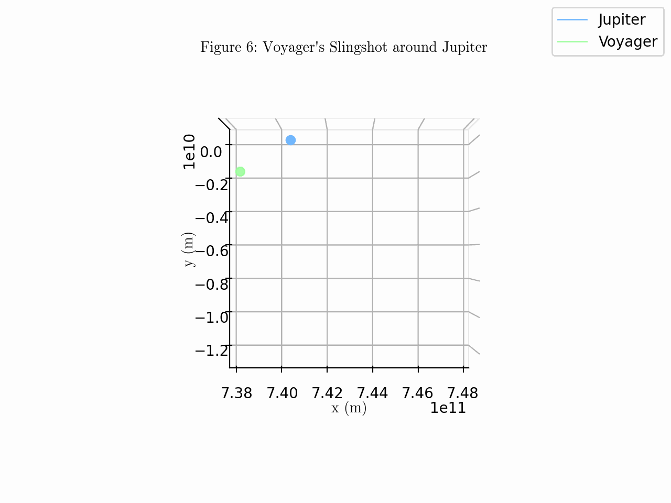

Slide 15
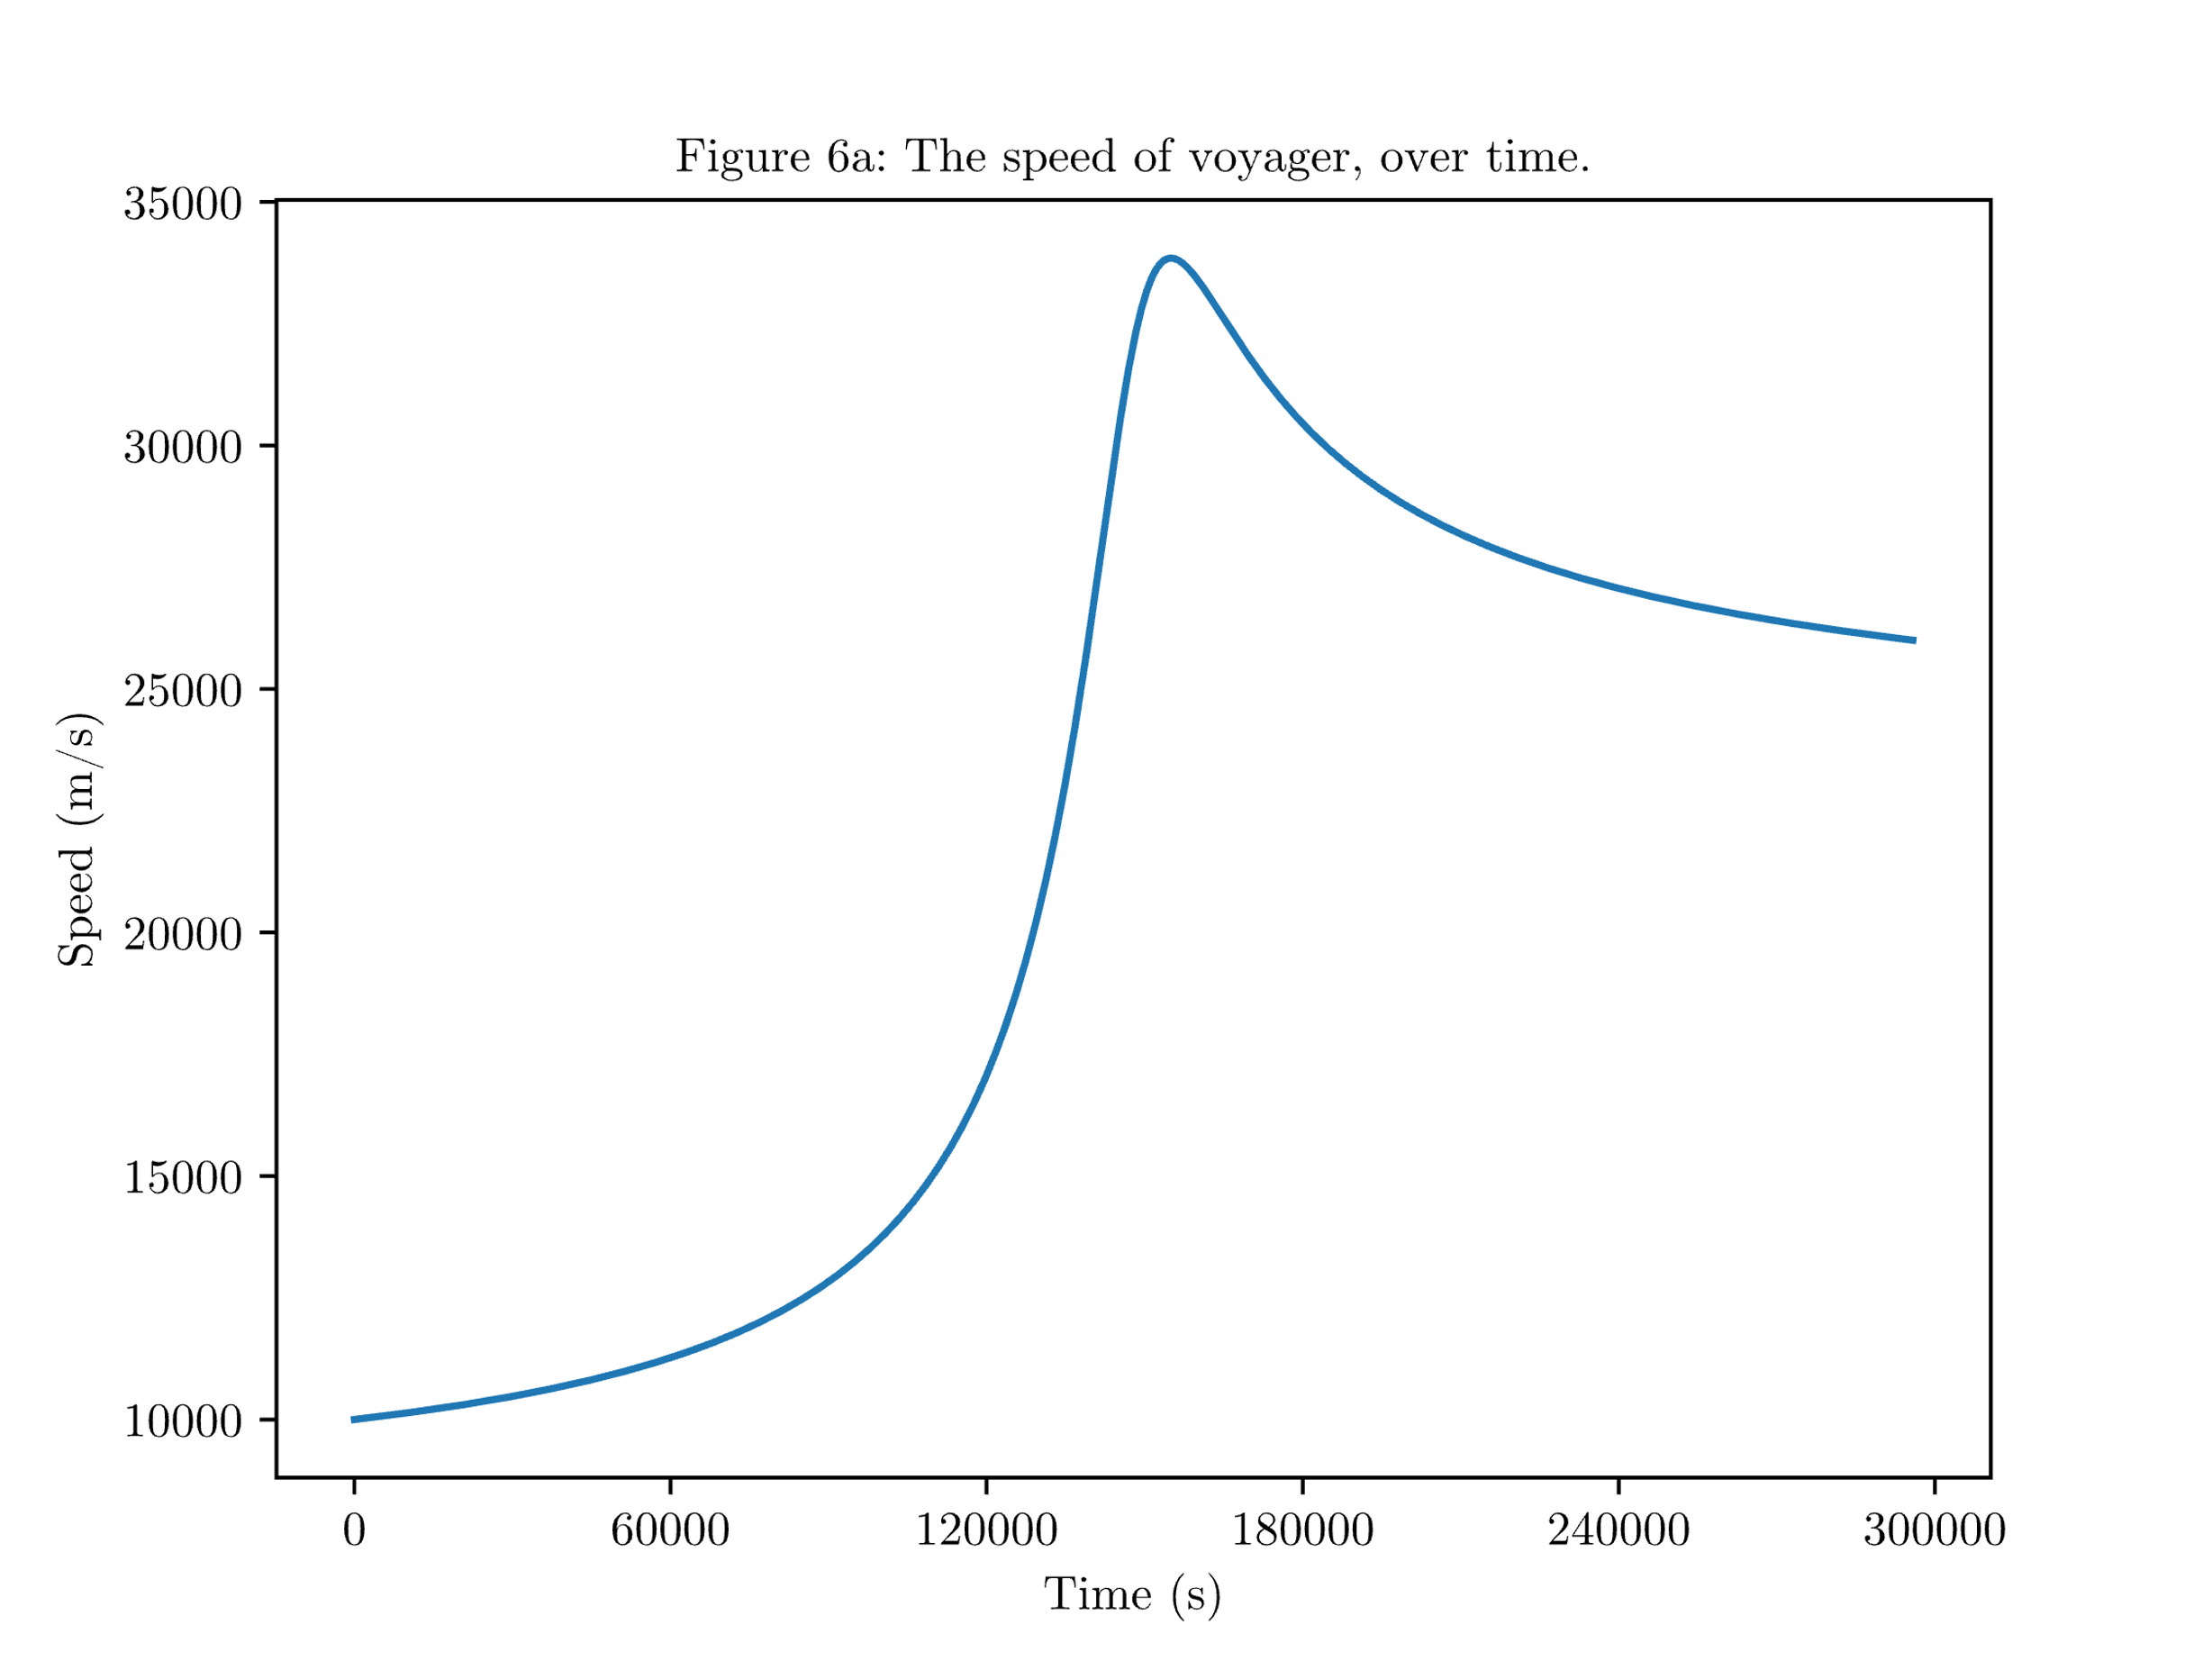

Slide 16
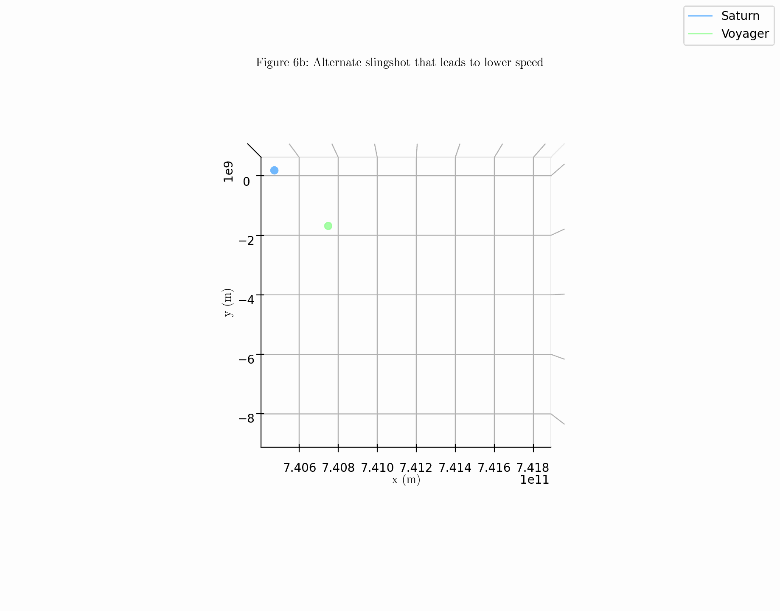

Slide 17
